Slide 1
Make Your Projects Better
by Learning Processes
Jan Schilt – GamingWorks
MSc HRD

Slide 2
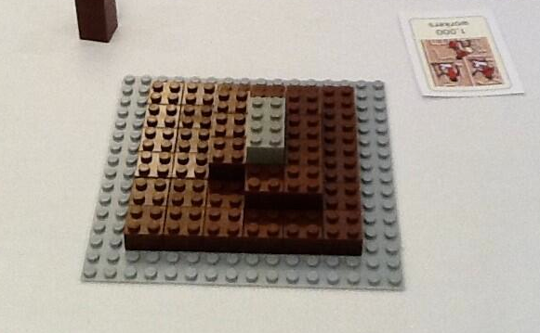
What is this?

Slide 3
This is what I hear all the time..
“This is typically our way of doing projects….”
“Yes, our projects are always out of time, budget and scope…”
“It doesn’t matter, this is our culture…”

Slide 4
Example this morning

Slide 6
We are not learning from our mistakes
We are not learning from our mistakes
We do not give our selves time to reflect, think and decide
We are not punished enough when we make mistakes
We accept the way we are doing
We are losing money, image and credits

Slide 7
About Learning
Learning is solving problems
Learning is about transferring what we have learned to a new context
Learning is changing behaviors
Learning must be challenging
Learning must be useful
Learning must be a cheap as possible

Slide 8
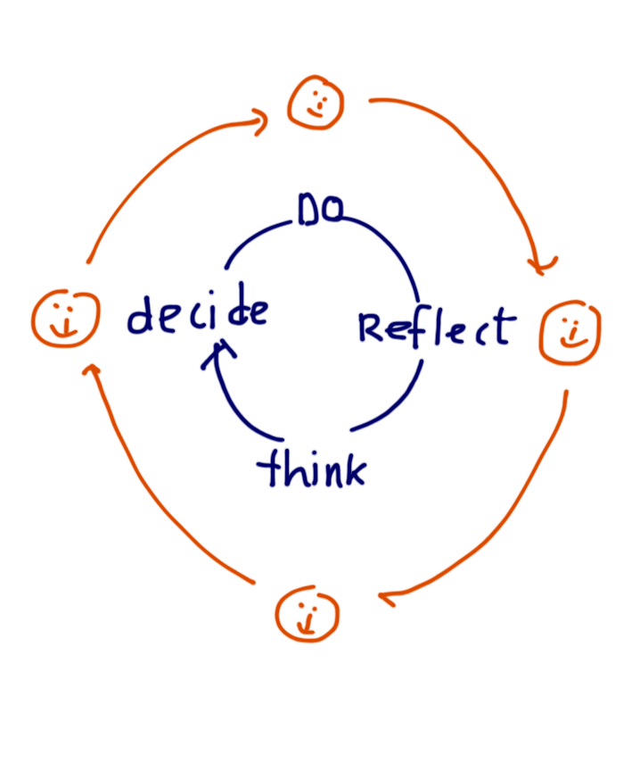
About Learning
KOLB
The Learning Process
Guidance
Learning styles
Doing > experimenting, solve problems by trying
Reflect > observe others, think first
Think > logical thinker, reading, understand
Decide > planner, technical issues,

Slide 9
Example from this morning
REFLECTION : Fail Factors
Poor project startup
Roles, responsibilities, processes
Lack of instruments to control/steer own work
Too many roles are steering
Lack of proactive approach
…

Slide 10
Example from this morning
THINK : Success Factors
Give whole PM team time to learn
Training, Kick off etc
Communicate expectations, roles, responsibilities AND AGREE, YES means YES
Use Work Packages, Tolerances, Empowerment to control and steer project on the execution level
Remove useless activities, double roles and responsibilities
Use PMO / PA to prepare decisions

Slide 11
Example from this morning
DECIDE :
COMMITMENT FROM EACH ROLE TO DO WHAT WE AGREED…..

Slide 12
About Learning
PRINCIPLES
ATTITUDE
RULES
BEHAVIOR
OUTCOME
OK?
YES
NO

Slide 13
Where can we learn in Projects
?????????????????????

Slide 14
Where can we learn in Projects
Project Start Up
Project team sessions
Project improvement sessions
One-to-one sessions PM - Employee
Project steering committees
Project closure sessions

Slide 15
How can we learn
Project Start Up
We use lessons learned from previous projects (project closure)
We teach participants the ‘way we want to run this project’ (principles, attitudes, behaviours). > kick off session

Slide 16
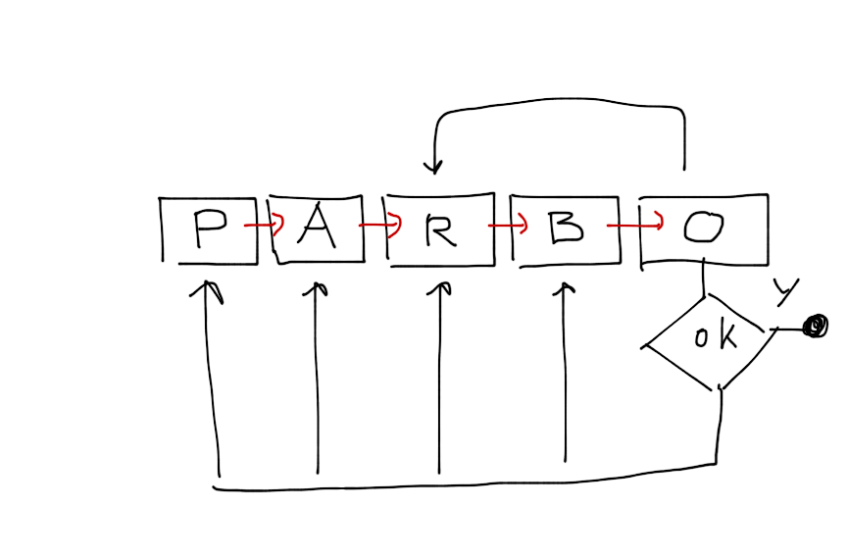
Where can we learn in Projects
Project team sessions
One-to-one sessions PM – Employee
Check the outcome, happy?
Root cause? P,A,R,B?
Interventions on the right level
As PM > use this to analyse
USE Action Learning Programs to fix

Slide 17
Action Learning Program
Team
Agreement
Responsibility
Learn from each other
Decide what to learn
Learning agenda
Training
Book
Dialog
Transfer plan, transfer to day to day work (project)

Slide 18
Where can we learn in Projects
Project improvement sessions
Project Steering Group
Use learning cycle of KOLB
Reflect
What are we doing?
Think
What can we do about this?
Decide
What are we going to do tomorrow
Do
Customer
Steering Group
Project Manager
Project Team

Slide 19
Where can we learn in Projects
Project Closure
With all stakeholders
Follow KOLB
Using PARBO
Take your time
Document, share
And DECIDE

Slide 20
Case 1 – Electricity Company
Project Startup with Project Management SIM
With all project roles
Explore ‘How are we going to do this?’
Document outcomes, agreement
Share key success factors
Outcomes:
Reference for reflection, open dialog
Clear roles and processes

Slide 21
Case 2 – Oil Storage Company
Project Improvement
New project : €50M, Assessment -> poor outcomes on
Requirements management, Proactivity, Controlling, reporting, informing
Execute Simulation and found solutions to avoid Risks
Outcomes:
List of improvements, Action Learning 40hours

Slide 22
Case 3 – Hospital
Project Steering Committee
Large Rebuild Project, with 3 suppliers
Problem > communication
Risk > costs, result, miscommunications
PM Sim with 3 parties
Team work, agree on how to solve issues
Outcomes:
First team that worked this way
Better understanding

Slide 23
Tips for better Projects by Learning
PLAN learning moments as part of project
Work with all roles within project
Apply professional reflection
Don’t accept making mistakes
Re-use what went well
Be honest to yourself
Complacency will lead to gridlock
Dare to give feedback (positive and negative)
Learn to learn
Learn as a WHOLE team

Slide 24
Thanks
Jan Schilt
CEO GamingWorks
www.gamingworks.nl
j.schilt@gamingworks.nl

