Slide 2
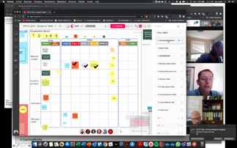
Why this simulation?
We are seeing more and more remote teams having to work together on projects from all over the world
Teams are struggling with collaboration tools and new ways of working
Virtual training can be tiring and boring and lacks interactive exercises
DevOps, Agile working, Scrum are new ways of working that teams are using to visualize, plan, execute and evaluate work
Remote working is not always easy….
THIS SIMULATION WILL HELP DEVELOP THESE SKILLS
© GamingWorks

Slide 3
About the simulation
Delegates will act as a team that works for Parts Unlimited, a company that manufactures and sells car parts.
The company is facing financial difficulties.
They are relying on the 'Phoenix Project’ to increase sales revenue and improve share price.
Business and IT must work together to ensure the project succeeds.
The team will implement DevOps principles to work faster, cheaper and with higher quality.
...and to support and enable the business to achieve goals.
Based on the book by Gene Kim, The Phoenix Project
© GamingWorks

Slide 4
Objectives
Explore and experience the essence of DevOps.
Explore and experience how to work as remote teams.
Discover how we can make DevOps a success when working with remote teams.
How to visualize work?
How to keep track of status and progress?
How to learn and improve?
How to effectively communicate and collaborate?
How to make effective decisions?
© GamingWorks

Slide 5
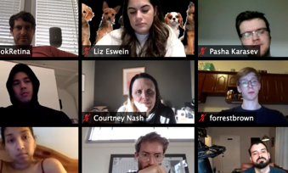
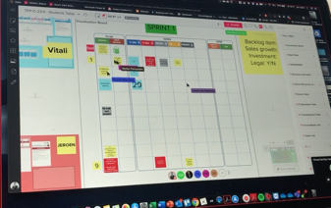
Setting of this simulation
5-7 remote participants
Using online communication & collaboration tool
Sharing a digital Learning Environment
4 sprints divided into
2 modules of 3 hours or
3 modules of 2 hours
© GamingWorks

Slide 6
Target audiences
(New) remote teams can learn how to start-up, use tools, work together, communicate as a team
Participants who followed a DevOps foundation or practitioner training (virtual) can learn to apply DevOps principles in a realistic case
Teams who want to improve their current way of working by reflection and experimenting in a safe environment
Non IT and Management teams who want to understand how DevOps works and how it can impact their organizations and teams.
© GamingWorks

Slide 7
Subjects
© GamingWorks

Slide 8
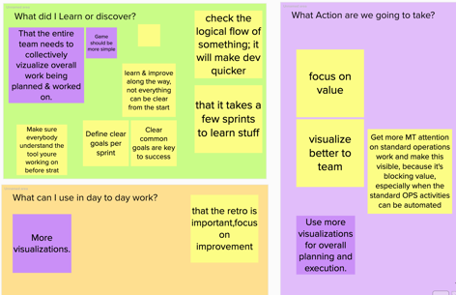
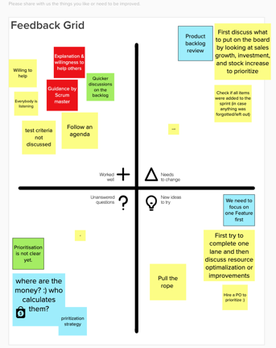
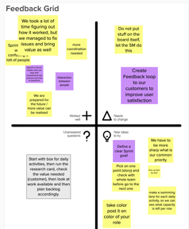
Lessons Learned
© GamingWorks

Slide 9
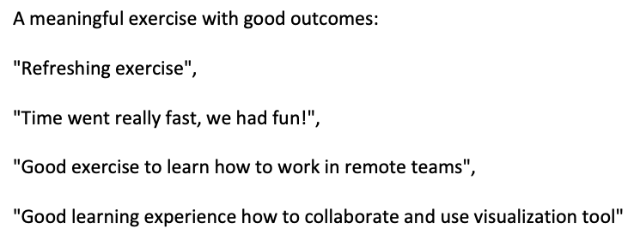
Feedback
© GamingWorks

Slide 10
Requirements
Students are using the Mural collaboration tool to plan and execute the work.
Students can use any communication tool to discuss, reflect and work together.
There is no specific knowledge needed on DevOps to experience this simulation.
Since this learning environment is new for many of the students, we strongly advice each of the students to prepare for this session by following the ‘Introduction Exercises’. This is a 30 minutes movie plus some exercises to learn about Mural and how the simulation works. This will help the team to start the simulation quicker.
© GamingWorks

Slide 11
The Phoenix Project
Thanks for your attention!

